Slide 1
PROJECT:
LIBRARY MANAGEMENT SYSTEM

Slide 2
(Library Management System)
MEMBERS:
BSEE21005 : FURQAN BARI.
BSEE21013 : ABDUL REHMAN.
BSEE21051 : MUGEES NASIR.
BSEE21063 : MUHAMMAD NOUMAN.
BSEE21080 : ABDUL RAHMAN.

Slide 3
DESCRIPTION:
In this LMS system , main classes used are Person, account, Librarian (administrator) and student.
Librarian class is inherited from account, person class.
Students class is being associated from person class by the use of function
Book class is being aggregated from student class, which pass the value as pointer of class.
Lastly, book class is being composed from librarian class, through which librarian can easily use the attributes of the book class

Slide 4
Concepts Used:
Inheritance
File Handling
Association
Aggregation
Composition
Polymorphism
Function Overloading
Singleton
Menu Drive Application

Slide 5
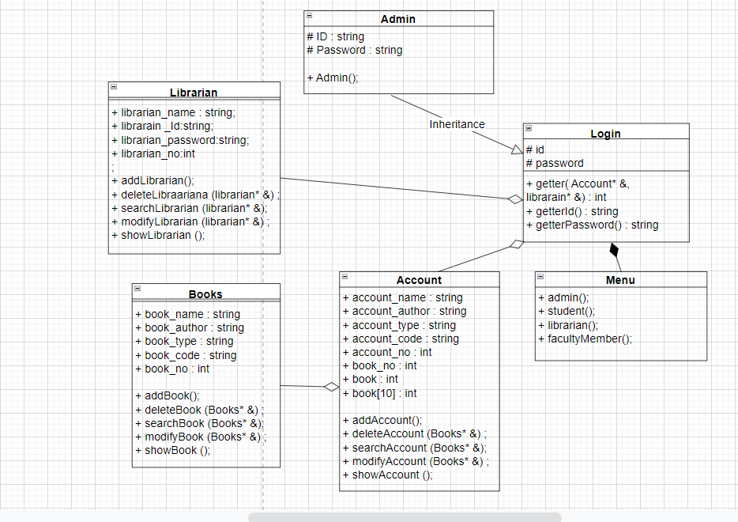

Slide 6
TASK LIST:
Task 01
library , book class and its all association.
Name
Abdul Rehman Khan
&
Mughees Nasir
Task 2
Member classes Book issue / deposit and return
Name
Abdul Rahman
Task 3
Member classes and login class , file handling, operator and finishing .
Name
Muhammad Nouman
&
Furqan bari

Slide 7

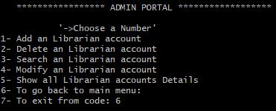
OUTPUT:
1 -> At first, user will be asked to enter ID no and password.
2-> Entering your ID no and password will take you to next page. In this example, we entered Admin ID and password which results in following output window.

Slide 8
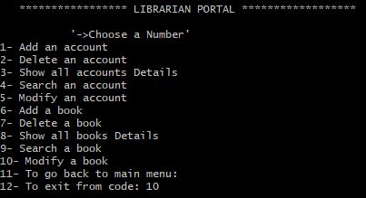
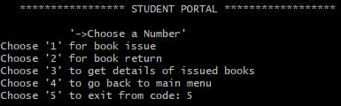
OUTPUT:
3-> This window will pop up in case entered ID and password matches with librarian credentials.
4-> This window will pop up in case entered ID and password matches with student credentials.

Slide 9
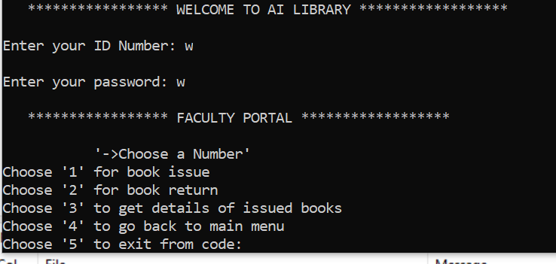
OUTPUT:

